Slide 1

Clara-fication: RegEx Weaponry
I love the smell of Regex in the morning!!
Notes:
Clara

Slide 2


Hello!
Notes:
Clara

Slide 3

regex…Whaaaat?
Pattern matching
Splunk regex commands
Field extraction tool
AGENDA
Notes:
Image downloaded from https://www.pngall.com/comic-png/download/59539
Clara

Slide 4

REGEX Defined
Regex = Regular Expressions
Matches patterns in text
Used too extract, delimit, or modify data
Notes:
Clara

Slide 5

When to regex in Splunk
Search Time
rex
regex
match
mvfind
replace
erex
Index Time
REGEX
LINE_BREAKER
TIME_PREFIX
EXTRACT-
SEDCMD-
…AND MORE!
Notes:
Cary
Thanks Clara. I’m lucky to be doing this with Clara, and frankly so are you! Her Clara-fication talks have all been great.
As many of you may know I love regular expressions. Regex is one of the most basic building block you have for use with Splunk. You can use it directly in your SPL when searching, or at index time before the data ever gets to where you can search it. They both have advantages and disadvantages, but regular expressions are available to you throughout Splunk.

Slide 6
Rex vs regex vs erex
Search Time
rex - extract fields & replace strings
regex - filter events
erex - muddle everything up - well, maybe. Extract fields when you don’t know enough about regular expressions
KABLAM!
Notes:
Cary
For example you have rex to allow you to both extract fields AND to modify the data before it is presented to you. With rex, you can do a very powerful eval-like function to extract the parts of the string into a field for more processing. And if you want to do search and replace-like functionality, rex will serve you well also.
With regex you can extend the capabilities of regular expressions into your searches (which normally don’t allow the regular expression syntax). That doesn’t mean that you searches will be faster, just that you can hone in on those juicy bits of data that you are trying to search for.
Erex is one of my least favorite regular expression-like functions IF you don’t know enough about regular expressions, erex, might be able to help you to learn more, but hopefully you can get used to them so that you never have to use erex ever again.

Slide 7
Match vs mvfind vs replace
Search Time
match - used in conditionals
mvfind - find a value from a multi-value field
replace - exchange one string for another
Notes:
Cary
Match is a very powerful way to see if a string (or a part of the string) matches a pattern. You typically use it in an eval expression, but you can use it in other places as well.
Mvfind is used to look through a multi-value field for a particular string pattern. Remember, regular expressions are pattern matching function, so this will allow you to find out which, if any, of those multiple values in the field match your regex pattern. It returns the index of the multi-value field that matches. Use it in an eval or where clause in your SPL.
And of course we can’t forget replace. This is different from the rex SED MODE, mostly to the syntax, but they do roughly the same thing.
Now our magnificent and all-knowing Clara will explain some of the ways that you can use regular expressions at index time.

Slide 8
Props.conf regex usage
Index Time
SEDCMD - modify the _raw text
LINE_BREAKER - define the beginning of events
TIME_PREFIX - define where to start looking for the timestamp
PLUS MORE!! - See the props.conf documentation
Notes:
Clara
Thanks for all that information, Cary! Super helpful.
Let’s just quickly go over the index time uses of regular expressions.
There are a lot of options in props.conf that use regular expressions. SEDCMD will use regular expressions to replace or modify the raw events. This is really helpful when it comes to masking pii data.
There are a lot of options when it comes to how to break raw data up into events, and one of those is LINE_BREAKER. This option will match a pattern in the data to start a new event with the proceeding data.
Lastly, TIME_PREFIX is the option to use if the timestamp field ends up in the middle of the event. Use regular expressions to find the start of the timestamp and extract it from there!
As I mentioned, there are so many options in props.conf and they all have a purpose, so check out the documentation!

Slide 9
transforms.conf regex usage
Index Time
REGEX - define the text you will match in the event
Can be used for search-time field extractions, as well
FORMAT - Format key/value pairs
Used with REGEX, required for index-time, optional for search-time
Notes:
Clara
But what is props without transforms?
In transforms.conf, there are a few options that use regular expressions. Most notably, this would be regex and format.
Regex is used for simple field extraction, but also can be used in conjunction with format to specify key value pairs, for more complicated extractions.
To learn more about how these options actually work, check out the documentation for some great examples.

Slide 10

Regex arguments
?#^@!
Tokens
. - single character
| - match either
\n - newline
\w - letter
\s - space
\d - digit
\. - period
Anchors
^ - start of string
$ - end of string
\b - word boundary
\B - non-word boundary
Quantifiers
* - zero or more (greedy)
+ - one or more (greedy)
? - zero or one
*? or +? - few matches (lazy)
{n} - exactly n
{n,m} - n to m instances
Groups
(?<field>...) - new field
(...) - capture everything
Substitution
$1 - group 1
${field} - field
g - global flag
s - single line flag
Character Classes
[abc] - match one letter
[^abc] - do not match
Notes:
Image downloaded from https://www.pngall.com/comic-png/download/59495
Should talk about the definition of each thing “what is a token/anchor/character class/etc.)
Clara
So let’s dive deeper into how to use regular expressions.
There are so many arguments, making this a very flexible tool.
We use tokens to match different types of data, such as just one character, to digits, to words
Anchors are used to define boundaries when matching.
Quantifiers, similar to what it sounds like, matches the number of occurrences for patterns.
Groups are used to create new fields or group patterns together, potentially for substitution,
Which is used, obviously, for substituting strings or characters
Lastly, we’ve got character classes, which can be used in groups, to match words or other patterns
I’m going to pass it back to Cary to explain some of this in more detail.

Slide 11
\w & \W
\s & \S
\d & \D
\b & \B
[...] & [^...]
This and not this:
The sets of characters and their opposites:
Words, spaces, digits, and word boundaries
Notes:
Image downloaded from https://www.pngall.com/comic-png/download/59539
Cary
Here we go. This is some fun syntax. If you want to find a word character use backslash-w. This are alphanumerics and an underscore. All other characters can be found using backslash-capital-W. They are opposites, and therefore complement each other.
Spaces, be they a regular space, a tab or a newline (and that newline would be in a multi-line expression) are matched using backslash-S. And anything that is not a white space you can match with backslash-Capital-S. You can match ANY CHARACTER using [\s\S]. Remember that, it will be on the quiz at the end of this presentation.
The D’s are for digits, and capital-D for non-digits.
Now the B’s are what are known as non-character matching regular expression, because it doesn’t match a character, just the position of the work boundary. That is a very different concept. It’s like saying match this from where the word starts, but don’t actually include any characters.
And finally there are the character sets. For example if I wanted to match only the digits 1 thru 5, I’d use a character set, with square bracket 1-5 end square bracket. And if I wanted to match anything but the digits 1 thru 5, I’d add the hat character as the first character after the first square bracket. There are many ways to do these sets, just list the characters that you want to match, or list ranges using a dash. These are very powerful and are you regex friends.

Slide 12
Greedy:
* & +
Lazy:
*? & +?
Specific:
{n} & {n,m}
Inspecific
?
How many did you say?:
Quantifiers will let you decide HOW MANY matches. Greedy vs Lazy is helpful to know.
Notes:
Image downloaded from https://www.pngall.com/comic-png/download/59539
Cary
Quantifiers allow you to say now many of a particular thing to match that you want to match. The wild cards are asterisk and plus. The asterisk means zero or more, while the plus means at least one match of the entity that precedes it. So if you have a single character before the asterisk or plus, you are saying that you want to match zero or more OR one or more of the single character that it follows. But if you have a character set, then it means that you can have zero or more, OR one or more of the set of things in the character set. These are also known as greedy matches, because they will look for the largest set of matches that it possibly can before stopping.
On the other hand the lazy matches are done just like the greedy matches I just talked about, but you put a question mark at the end. That means that you want it to stop after the first match that you find, and don’t match any more. There have been many times that I’ve been able to use lazy matched to match the string I wanted without going beyond where I want the match to stop. For example if you want to stop you match at the end of the first sentence from where you matching started, then you could do that with C plus question mark, so that you don’t go on to matching the second, third and fourth sentence ending punctuation marks in the text you are matching from.
And you can get down right exact to matching an exact number of a particular range of matches. Within the curly braces the first number represents the minimum number of matches and adding an optional second number- separated by a comma - you can match at most the second number of matches of the entity that precexes it.
Finally the last one, the question mark says that the thing that precedes it is completely option, and you can match it zero or one time.

Slide 13
Start of String:
^ & \A
End of String:
$ & \Z
Start of Match:
\G
(Non)?Word:
\b & \B
WHERE YOU AT?
Anchors will let you choose WHERE to start matching.
These do not consume characters, but enable boundaries and positions.
Notes:
Image downloaded from https://www.pngall.com/comic-png/download/59539
Cary
Sometimes it is best to use a regular expression that is based off the beginning or end of a string. The hat or caret character or a backslash-capital-A can be used to tell the regular expression to match starting at the beginning of a string. The Dollar or backslash-capital-Z tell the regex to match the strings right up to the end of the string. These can make the match not only work faster, but can also make better matches within the string, particularly if you are trying to match something that may be match in more than one place in the string.
Backslash-capital-G is not commonly used, so I’m not going to go into it right now.
Word boundaries can be used as anchor points without actually capturing any character. A word boundary is just like it sounds - it’s the boundary between word, like a space, comma, semicolon before or after a word (think backslash-W here for word characters) - like “space cat space”. The backslash-capital-B also doesn’t actually match any character but will match where the character boundary will be when there is a word character before or after the backslash-capital-B. I’ll show more of this when I do a demo later on.

Slide 14
regexamples - Lazy vs Greedy
”Clara” and ”Cary” teach REGEX
x ”.*” and ”.+” match ”Clara” and ”Cary”
Because it is greedy x ”.*?” and ”.+?” match ”Clara” OR ”Cary”
Because it is lazy
Notes:
Cary
We’ve already talked about greedy and lazy matches, but this will make it more understandable - I hope. The example text in RED can be split very differently if you use a lazy match versus a greedy match. It your regex is using the double quotes to match the beginning and end of what you want to match, then a greedy match for the internal text will go all the way from the beginning of Clara all the way to the end of Cary. So it will match from the first double quote all the way to the last one.
The lazy match will start at the first double quote and match to the first double quote that it finds, so it can be used to find just Clara, or just Cary. So a lazy match will just do a match for the smallest amount possible, while the greedy match will go just as far as it can, grabbing up every character it can find from the start to the end.

Slide 15
REGEXAMPLES - Named Fields
If you liked it, then you shoulda put a name on it:
pre-regex(?<name>regex)post-regex
The field name will then contain the value matched by the regex pattern
2022-10-18T10:15:00.000 Clara and Cary amaze audience at BSidesSPL22
X .*\d\s(?<teachers>(\w+\s?){3})\samaze.*
puts “Clara and Cary” text into a field called teachers
Notes:
Cary
Named fields are the heart of field extraction and we’ll demonstrate some of this later, but for now, think of named fields as describing the text you want to extract and putting it into a field with the given name. AS you construct the regular expression, you will likely want to have some text before the named field and some after, though that is not necessary, and it could even be an anchor or another named field. Then you may need some text after the named field in order to show where the end of the field should be.
Now Clara has some more great examples for you. Take it away, Clara.

Slide 16

REGEXAMPLES - Named Fields Extended
2022-10-18T10:15:00.000 Clara and Cary amaze audience at BSidesSPL22
^(\d|-)+T(\d|:)+\.\d{3}\s.*
(?<timestamp>[^\s]+)\s(?<message>.*)
Digits OR -
Digits OR :
Exactly 3 digits
Everything else after space
Create timestamp field with everything up to space
Create message field with everything after space
Notes:
Clara
I love all of these examples so far!
The next example we’ve got for you is a spin off of the last example.
So here, we’ve got the same message used in the previous example, but in this first bullet, we’re not actually putting anything into a field, we’re just matching it all.
I’ve got my timestamp matched in the red text, using \d and some quantifiers, among other things, and in orange, i’m using a greedy quantifier to match everything after the timestamp.
I also show here a way to group this into two fields. I’m looking for a space to grab the timestamp, and then i’m being greedy, again, to put the message into it’s field. I could have used the longer definition in the first example to create a timestamp field, but looking for a space is a shorter method, though it can match things that don’t match the timestamp format.

Slide 17
REGEXAMPLES - Replace
Regex is the worst tool ever!
Replace “worst” with “best”
| rex mode=sed “s/worst/best/g”
rex is the command for field extractions or character replacement
mode=sed is the replacement mode (stream editor)
s is a command for substitute
g is a flag for global
Notes:
Clara
I want to quickly go into replacements. This will be a little bit more detailed in an upcoming demo.
Basically, we use the rex command at search time to run replacements. mode=sed is the option to use to replace values. Sed stands for stream editor This needs to be inside quotes, at the beginning you can use s for string replacement, y for character replacements. The flags at the end can be g for global or a number to indicate location in the string. There is a similar eval function called replace that can also be used instead of mode=sed. They are similar in how they work, so check it out!
Replacing text is really beneficial, for example, when you want to remove the domain from an email address, just to get the username.

Slide 18
REGEXAMPLES
Cary and Clara rock at regex!
Keep “rock regex” but substitute “Cary and Clara”
| rex mode=sed “s/(.*)(rock at regex)/I $2/g”
I rock at regex!
Creating two groups
Keeping the second group and replacing the rest
*Possible to do this with just one group (rock at regex) and use $1
Notes:
Clara
One more thing about replacement, is that you can actually still keep a matched group and replace other things.
In this example, we created two groups, the first group matches everything up to the second group, which matches “rock at regex”
In my replacement section, we are replacing the string with “I” and adding in the second matched group to create the string “I rock at regex”
This can be really helpful when you only need to keep a part of a string but replace or remove the rest of it. Hey Cary, can you help us out with a few more examples?

Slide 19
regexamples
Delimited values:
“The value”
“(?<the_value>[^”]+)”
Delimited lists:
First, 2nd, third
(?<one>[^,]+),(?<two>[^,]+),(?<three>[^,]+)
Notes:
Cary
Thanks Clara, I do have some more examples.
This example is important for the use in doing delimited lists of things to be captured in named fields, though it can also be used in many other places. When you delimit a string like with quotes, you will probably want to use the character class list option to define the named field value to be the set of characters that don’t include the final delimiter (another quote). So you use the square-bracket-hat(or caret)-character-end-square-bracket notation for the set of characters that are not the quote (or other character that is your delimiter).
When you have a list of values, you can use the same trick. Do the exclusionary character set matching notation to get your values, and then put your separator between those to grab the items from the list. These are quite efficient and will usually find the fields that you want with more exactness.

Slide 20
REgexamples
Extract IP address
10.0.0.1
(?<ip_address>(\d+\.){3}\d+)
Create field ip_address
Match digit(s). three times followed by more digits
Notes:
Cary
This is a very basic IP address extraction example to show how you can use the enumerations. In this example we’re just going to assume that you are looking for four sets of digits separated by a period. So our named field extraction will find some digits followed by a period, do that three times in a row, then find more digits at the end. The parentheses define the set of characters to be enumerated the three times, so it will look for the 10.0.0. Using the first enumeration and then look for the 1 at the end of that string. And there you have the IP address.

Slide 21
REgexamples
Extract URL
https://bsidessplunk.com
(?<url>(https?:\/\/)?(www.)?[a-z0-9]+\.[a-z]+)
Match numbers and characters before .
Match http(s):// if it exists
Create field url
Match www. if it exists
Match characters after .
Notes:
Cary
Another useful example for finding a URL, this example looks for the basic pieces of a URL, including the http OR https (the s character is optional using the question mark after it), Then IF you have a www., it will find that, then the first possible set of character for the domain, and finally the top level domain at the end. It doesn’t go beyond a simple domain here, but you should try experimenting to see if you can get even more complicated URLs. For example, there are URL with more then the www.domain.tld, and can also have more parts afterwards as well.
Now I’ll turn it over to Clara for a demo of using Regular expressions within SPL.

Slide 22

REGEX SPL
A demo

Slide 23
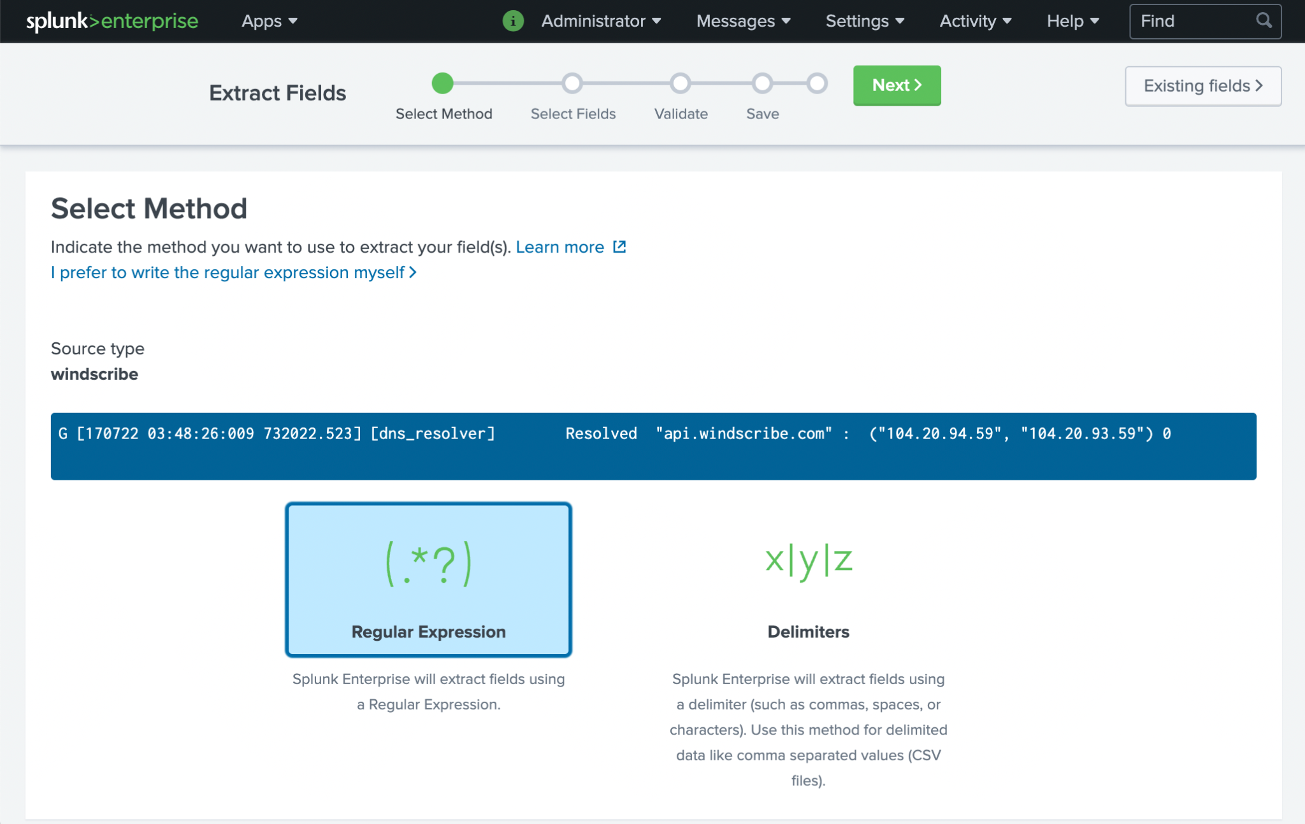
Field extraction tool
Place your screenshot here

Slide 24
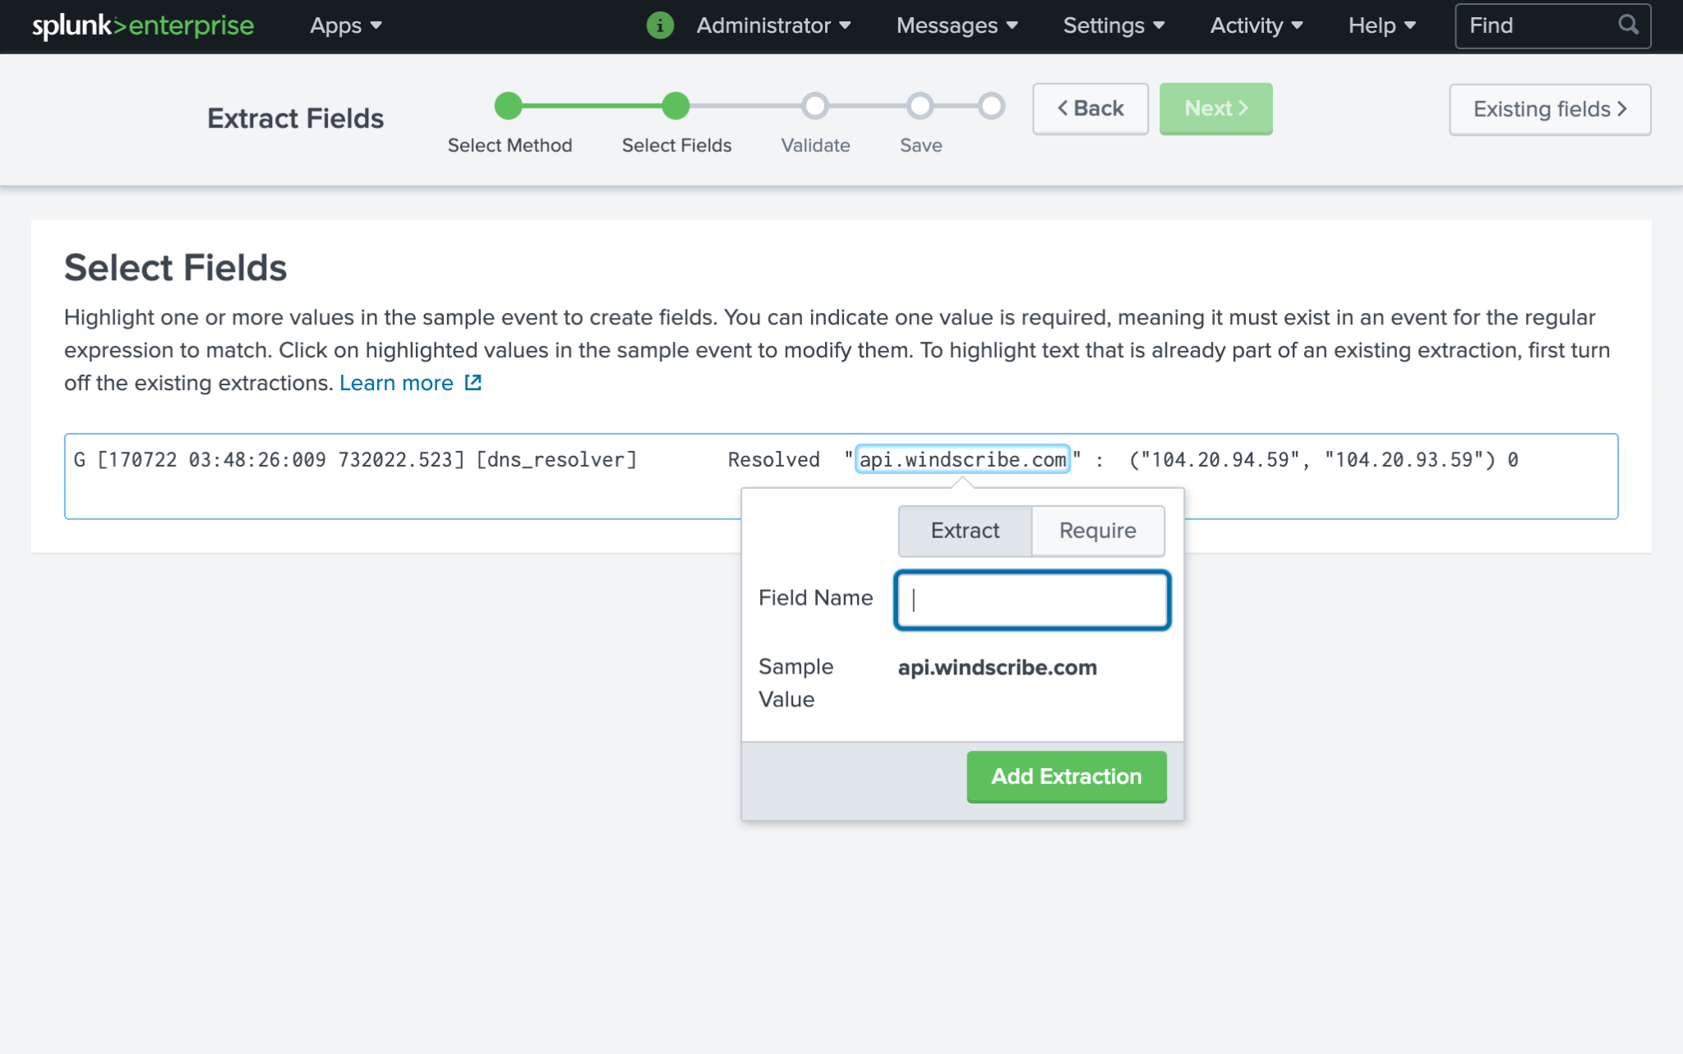
Field extraction tool
Place your screenshot here

Slide 25
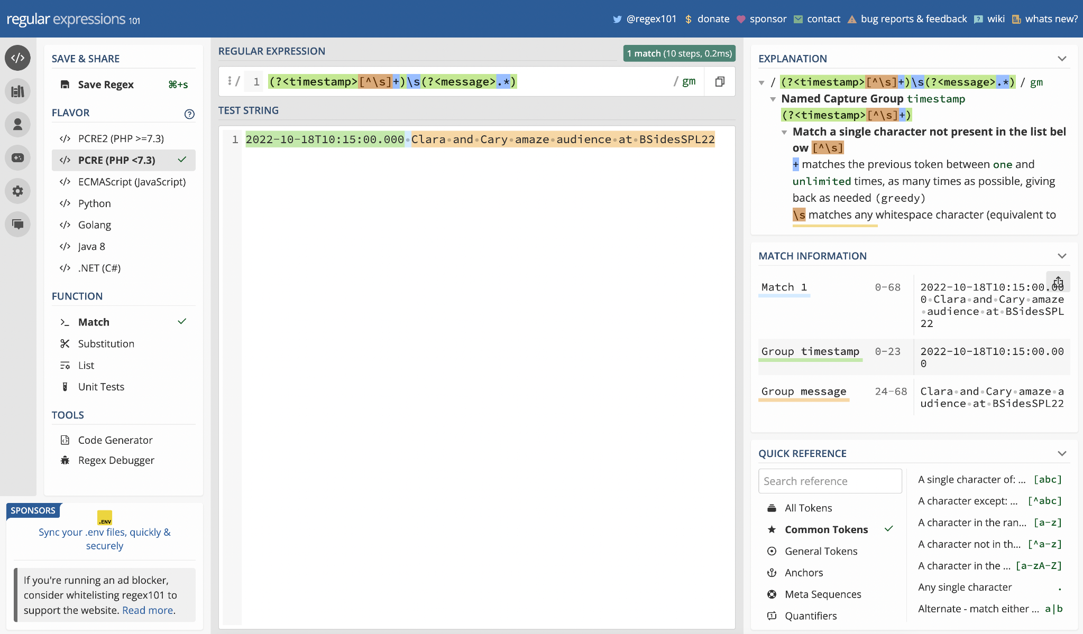
Regex101.com
A demo
Place your screenshot here

Slide 26
Regex is a tool for pattern matching and can be used in Splunk to extract fields or remove/replace strings/events
Regex is all powerful and all knowing
Regex is not easy in the beginning but is worth the time to learn
Takeaways
Notes:
Image downloaded from https://www.pngall.com/comic-png/download/59539
Clara
Demos are awesome, aren’t they? I hope you’ve all picked up a few things from this session. Some of the main things to remember about regular expressions are that it might be hard at first, but it gets easier and is definitely worth the effort to learn! Regular expressions can be used for so many things and can really improve searches and raw data.

Slide 27

Resources
Documentation
regex command
rex command
erex command
match function
mvfind function
replace function
props.conf spec
transforms.conf spec
Other Sessions
conf17: Regex in Your SPL
PLA1261B - Beyond REGULAR Regular Expressions - v3.0
Beyond REGULAR Regular Expressions v2.0
& v2.0 PDF
Practice
Regex101
Regex Golf
Notes:
Don’t forget to check out some of the documentation here. There is so much more out there, too, so go exploring and learn some fun things!

Slide 28

THANKS!
Notes:
Thanks for tuning in! Let us know if you’ve got any feedback or questions!!

